Slide 1
NFT Token gate

Slide 2


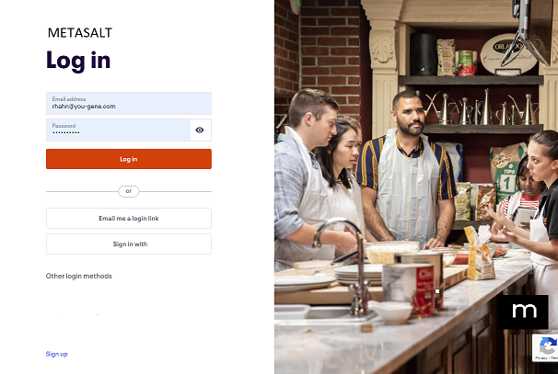
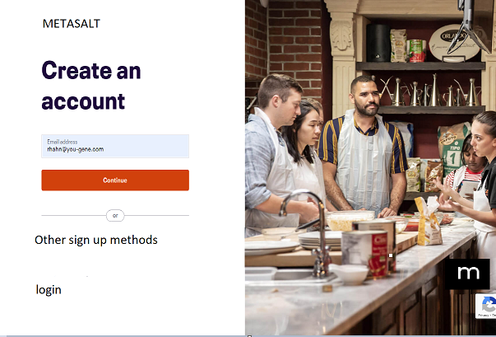
Search NFT gates …
+ CREATE NFT
+ CREATE NFT GATE
+BUY $METASALT
BUY/SELL NFTs
LOGIN
SIGNUP
If not logged in
If not logged in
Menu bar BEFORE LOGIN

Slide 3
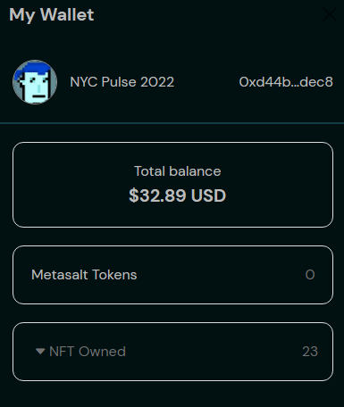
Search NFT Gates …
+ CREATE NFT
+ CREATE NFT GATE
+BUY $METASALT
BUY/SELL NFTs
PROFILE
MY NFTS
All
Brands
Collections
Authenticate
My NFT Gates
My Market
My Brands
My Collections
My History
My Settings
Logout
My NFTs
Search box is same
But now searching NFT GATES
Remove menu
Just need a + sign that redirects to Create NFT page
No Brand and Collections submenu. These items will be in flow
New NFT Gate
Just a “+” sign
Redirects to new create NFT Gate page
Just a “+” sign
No button
Redirects to “Trade
$Metasat” token page
Links to entire marketplace
Links to marketplace filtered just on brands
Links to marketplace filtered just on collections from all brands
*Ranking and Social can stay just on home page w/no menu
Add “My NFT Gates"
Stays same, but change “My Wallet” to “My NFTs”
Menu bar AFTER LOGIN
DOCS
Move Docs Button to footer

Slide 4
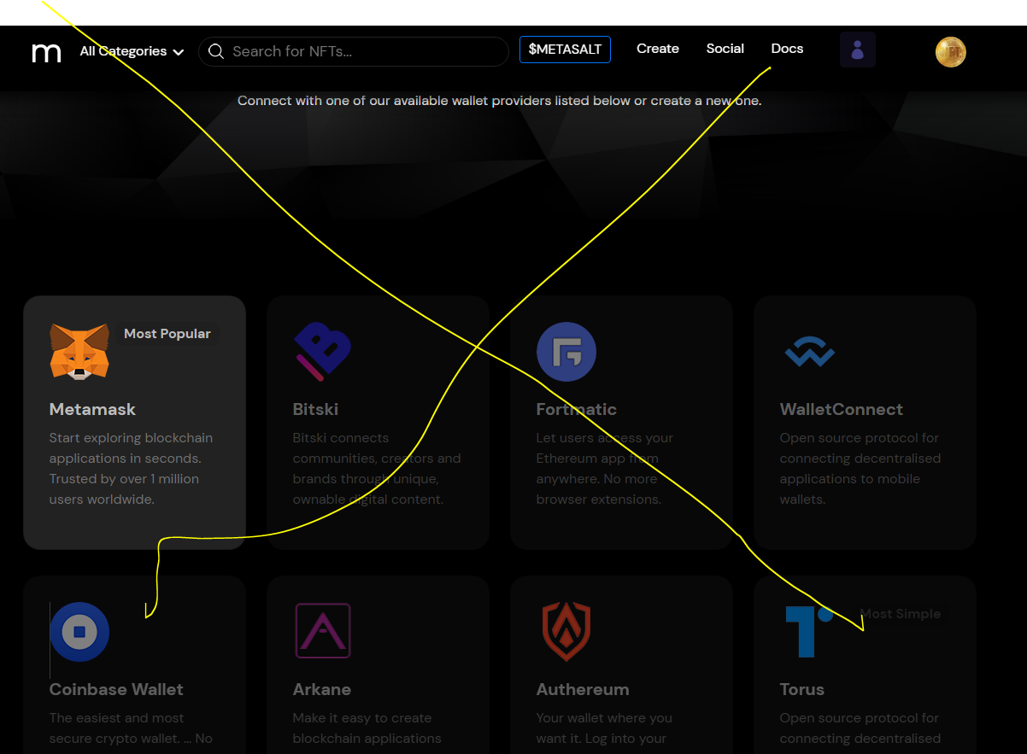
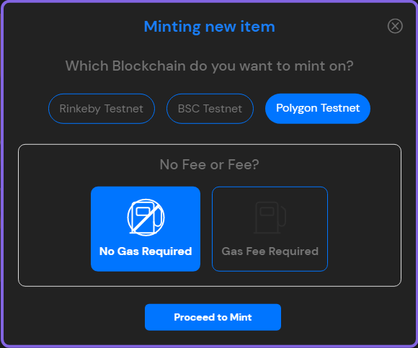
Search NFT gates …
+ CREATE NFT
+ CREATE NFT GATE
+BUY $METASALT
BUY/SELL NFTs
PROFILE
MY NFTS
If passwordless, check if wallet address is in db
If not, popup saying “you can browse and use all features. However, to buy/sell and create, you must create Metamask account
Link to Download Metamask
Message – Only chrome supported at this time
Delete this page
Check if logged into Metamask

Slide 5
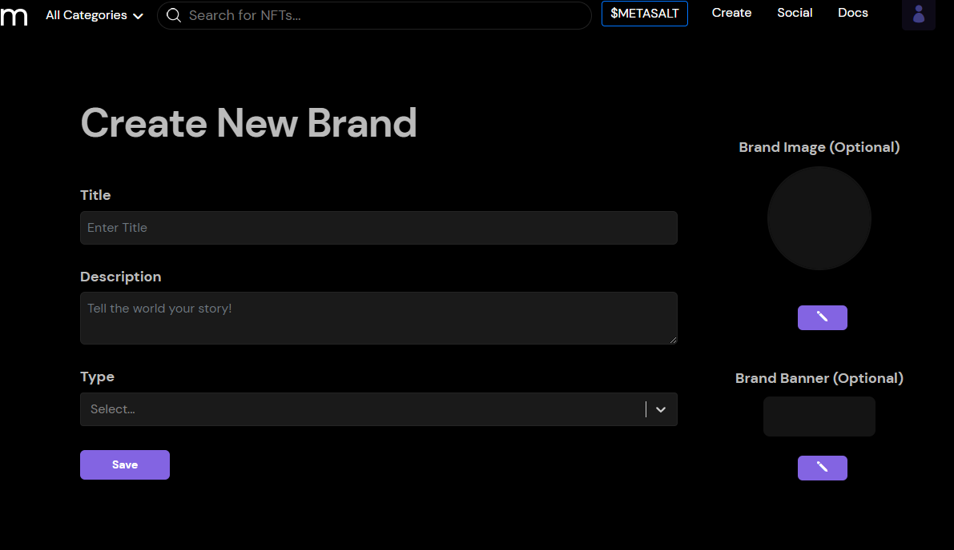
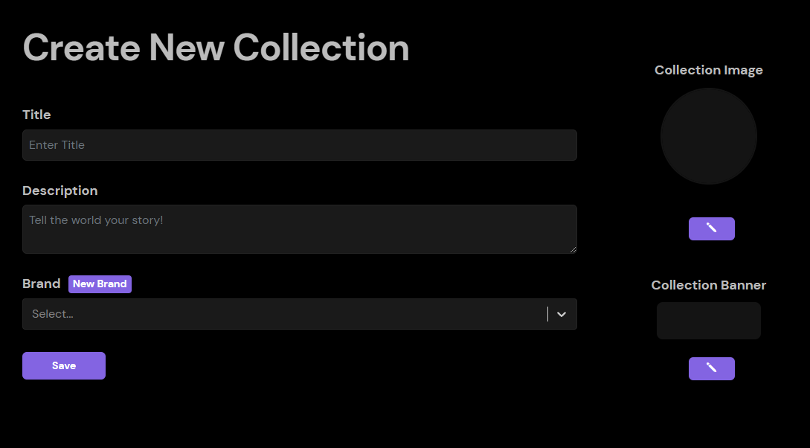
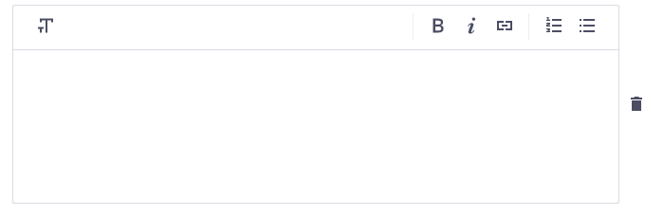
Search NFT gates …
+ CREATE NFT
+ CREATE NFT GATE
+BUY $METASALT
BUY/SELL NFTs
PROFILE
MY NFTS
All NFTs
BRAND
Details
Rolex
Gucci
Create
You must create at least one brand
Name your NFT
COLLECTION
You must create at least one collection
NFT Name*
Be clear and descriptive
Submariner
Dayjust
Diamonds
Create
0/35
Describe your NFT
Details
Content
Authentication (optional)
0/150
Price
Number
Royalties
Number of NFTs that should be minted
Must range from 1 to 10,000
Discard
Save & Continue

Slide 6
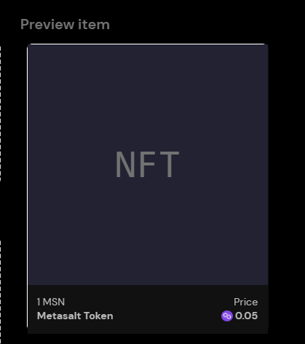
Search NFT gates …
+ CREATE NFT
+ CREATE NFT GATE
+BUY $METASALT
BUY/SELL NFTs
PROFILE
MY NFTS
All NFTs
Content
BRAND
Diamond NFT
Rolex
COLLECTION
Upload NFT Image
Submariner
PNG, JPG, FIG, WEBP, MPR3, Max 200B
Browse
Details
Content
Authentication (optional)
Price
Royalties
Discard
Save & Continue

Slide 7
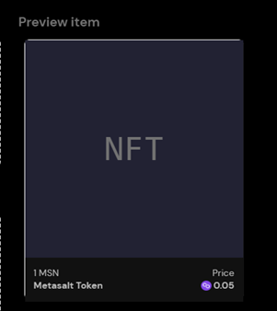
Search NFT gates …
+ CREATE NFT
+ CREATE NFT GATE
+BUY $METASALT
BUY/SELL NFTs
PROFILE
MY NFTS
All NFTs
Authentication
BRAND
Diamond NFT
Rolex
COLLECTION
Submariner
Upload QR code (Optional)
Scan an Image File
Request Camera Permission
Details
Content
Authentication (optional)
Price
Royalties
Discard
Save & Continue

Slide 8
Search NFT gates …
+ CREATE NFT
+ CREATE NFT GATE
+BUY $METASALT
BUY/SELL NFTs
PROFILE
MY NFTS
All NFTs
BRAND
Price
Rolex
Enter starting price
COLLECTION
Submariner
0.05
Details
Content
Authentication (optional)
Price
Royalties
Discard
Save & Continue

Slide 9
Search NFT gates …
+ CREATE NFT
+ CREATE NFT GATE
+BUY $METASALT
BUY/SELL NFTs
PROFILE
MY NFTS
All NFTs
BRAND
Royalties
Rolex
How much will each sale return to original minter
COLLECTION
Submariner
Suggested 3%. Max is 50%
Details
Content
Authentication (optional)
Price
Royalties
Discard
Save & Continue

Slide 10
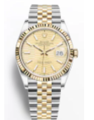
Search NFT gates …
+ CREATE NFT
+ CREATE NFT GATE
+BUY $METASALT
BUY/SELL NFTs
PROFILE
MY NFTS
All NFTs
Listing of all NFTs you have created
Diamonds
Brand
Collection
Mnited
Sold
MINT NOW
Rolex
Dayjust
0
0
Platinum
Brand
Collection
Mnited
Sold
03/06/2022
Rolex
Nightjust
100
56
Gold
Brand
Collection
Mnited
Sold
04/13/2022
Rolex
Midjust
100
45
+CREATE NFT

Slide 11
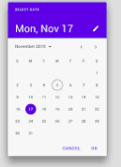
Search NFT gates …
+ CREATE NFT
+ CREATE NFT GATE
+BUY $METASALT
BUY/SELL NFTs
PROFILE
MY NFTS
NFT GATE TYPE
All NFT Gates
Memberships
Events
Media
Products
Details
You must finish to publish
Date Picker
Name your NFT gate
STATUS
Draft
Scheduled
Publish
Unpublish
NFT Gate Name*
Be clear and descriptive
You must finish to publish
0/35
BRAND
Describe what it does and why. Add details to get them excited
Rolex
Gucci
Create
You must create at least one brand
COLLECTION
You must create at least one collection
Submariner
Dayjust
Diamonds
Create
0/150
Details
NFTs
Content
Scroll Down

Slide 12
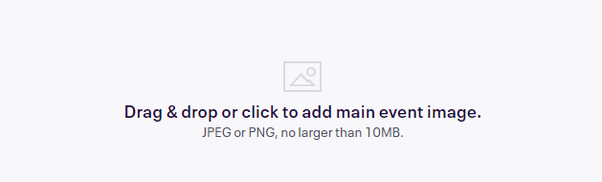
Search NFT gates …
+ CREATE NFT
+ CREATE NFT GATE
+BUY $METASALT
BUY/SELL NFTs
PROFILE
MY NFTS
NFT GATE TYPE
All NFT Gates
Memberships
STATUS
Details
Draft
BRAND
Rolex
This is the first image attendees will see at the top of your listing. Use a high quality image: 2160x1080px (2:1 ratio).
COLLECTION
Submariner
Details
NFTs
Content
Discard
Save & Continue

Slide 13
Search NFT Gates …
+ CREATE NFT
+ CREATE NFT GATE
+BUY $METASALT
BUY/SELL NFTs
PROFILE
MY NFTS
NFT GATE TYPE
All NFT Gates
Memberships
NFTs
STATUS
Rolex Membership NFT Gate
Draft
Select the NFTs that give access to this NFT Gate
BRAND
+CREATE NFT
Rolex
COLLECTION
Diamonds
Minted
Sold
02/12/2022
100
89
DayJust
Platinum
03/05/2022
Minted
Sold
100
56
Details
NFTs
Gold
04/13/2022
Minted
Sold
100
45
Content
Discard
Save & Continue

Slide 14
Search NFT Gates …
+ CREATE NFT
+ CREATE NFT GATE
+BUY $METASALT
BUY/SELL NFTs
PROFILE
MY NFTS
NFT GATE TYPE
All NFT Gates
Memberships
Content
STATUS
Rolex Membership NFT Gate
Draft
Add the content that is revealed to NFT Owners
BRAND
+CREATE CONTENT
Rolex
COLLECTION
YouTube
02/12/2022
DayJust
Discord
03/05/2022
Details
NFTs
QR code
04/13/2022
Content
Discard
Save & Continue

Slide 15
Search NFT Gates …
+ CREATE NFT
+ CREATE NFT GATE
+BUY $METASALT
BUY/SELL NFTs
PROFILE
MY NFTS
NFT GATE TYPE
All NFT Gates
Memberships
Content
STATUS
Rolex Membership NFT Gate
Add Content
Popup
Draft
Add the content that is revealed to NFT Owners
BRAND
+CREATE CONTENT
Rolex
COLLECTION
YouTube
02/12/2022
DayJust
Discord
03/05/2022
Details
NFTs
QR code
04/13/2022
Content
Discard
Save & Continue

Slide 16
Search NFT Gates …
+ CREATE NFT
+ CREATE NFT GATE
+BUY $METASALT
BUY/SELL NFTs
PROFILE
MY NFTS
NFT GATE TYPE
All NFT Gates
Memberships
Content
STATUS
Rolex Membership NFT Gate
Draft
Add the content that is revealed to NFT Owners
BRAND
+CREATE CONTENT
Rolex
COLLECTION
YouTube
02/12/2022
DayJust
Discord
03/05/2022
Details
NFTs
QR code
04/13/2022
Content
Website
04/13/2022
Discard
Save & Continue

Slide 17
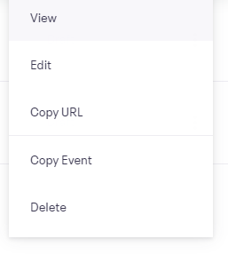
Search NFT Gates …
+ CREATE NFT
+ CREATE NFT GATE
+BUY $METASALT
BUY/SELL NFTs
PROFILE
MY NFTS
ALL NFT GATES
Listing of all NFT Gates you have created
Type
Brand
Collection
Date
Status
Rolex Membership NFT Gate
Membership
Rolex
Dayjust
02/12/22
Published
Type
Brand
Collection
Date
Status
Gucci Membership NFT Gate
Membership
Gucci
HandBag
03/13/22
Draft
+CREATE NFT GATE

